Slide 1
Applications Development Practice 2 (ADP262S) Term 2 Lesson 2
Lecturers: Arinze Anikwue
Radford Burger
Kruben Naidoo

Slide 2
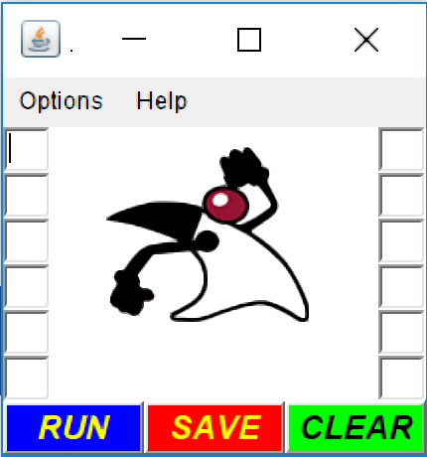
Swing Made Easy – 9 simple steps
FRAME
Title bar
Menu bar
Textfields
JLabel (duke.running.gif)
Buttons

Slide 3
Swing Made Easy – 9 simple steps contd.
FRAME
panelCenter
panelWest
panelEast
panelSouth

Slide 4
Questions?

